Slide 1

Shade Ennis
Tree Project

Slide 2
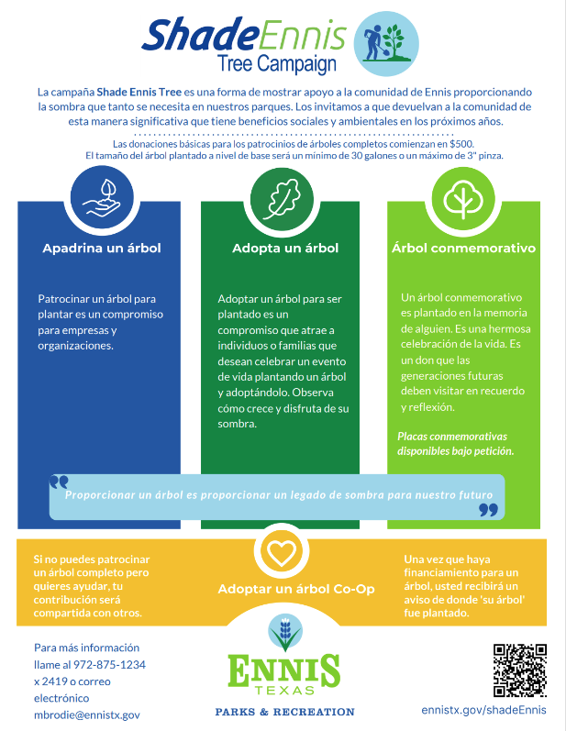
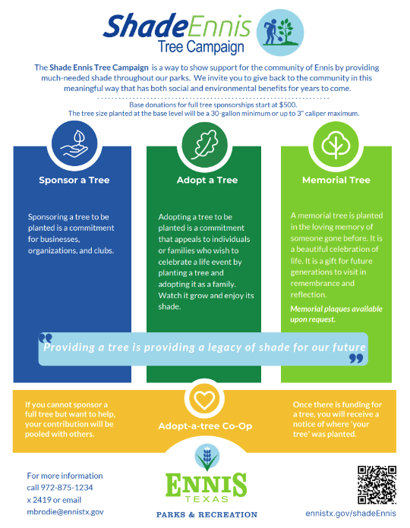

Slide 3

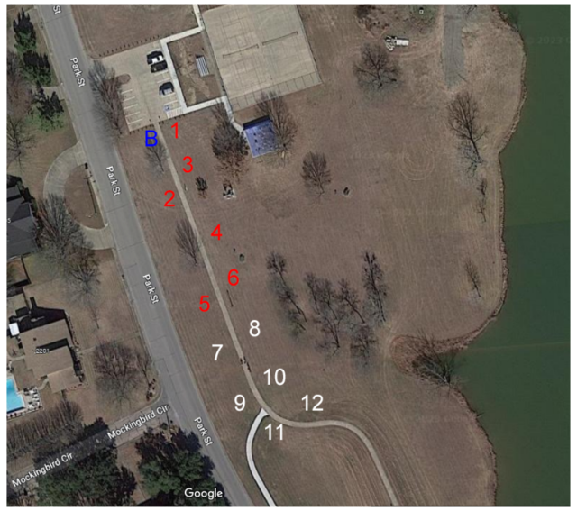

Rotary Park tree
planting map

Slide 4
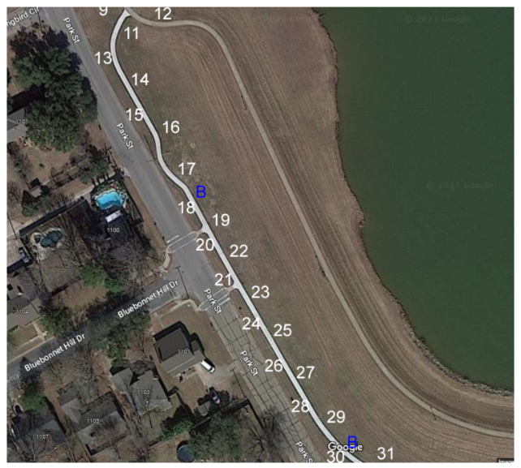
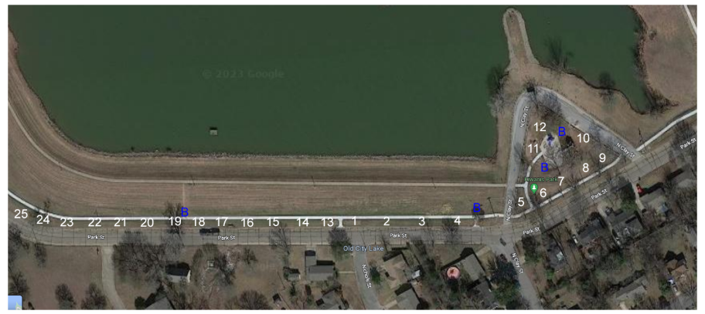
Rotary & Kiwanis Tree
planting map
Rotary Park
Kiwanis Park

Slide 5
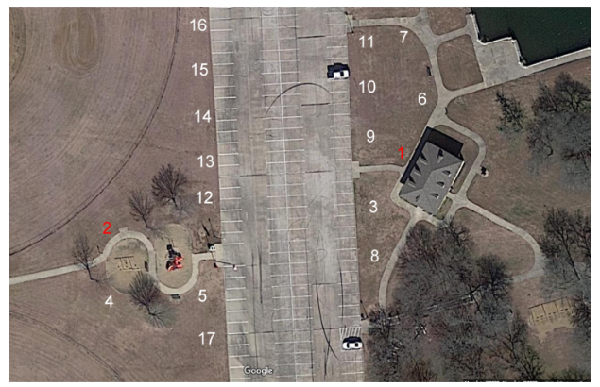

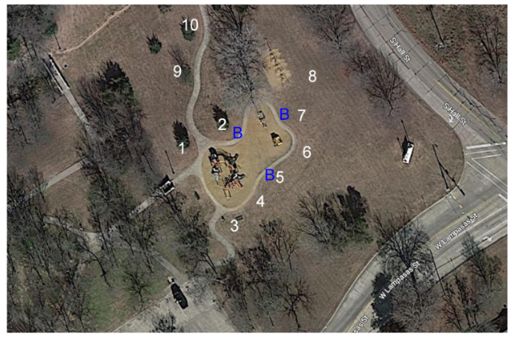
Lions Park
Bluebonnet
Park

Slide 6
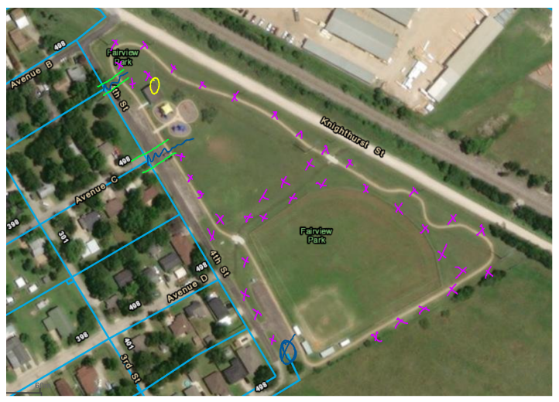

IOOF at Fairview Park Tree planting map

Slide 7
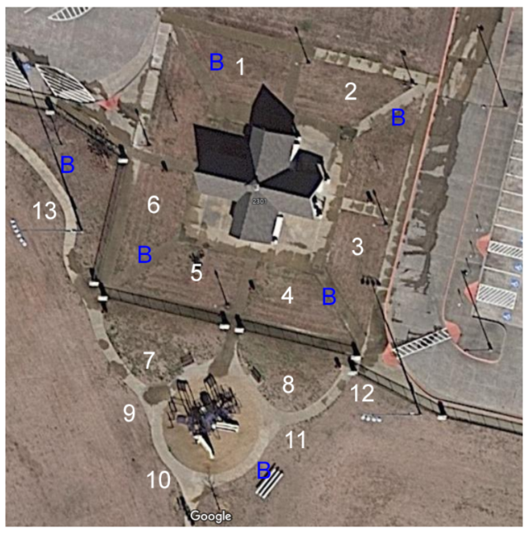

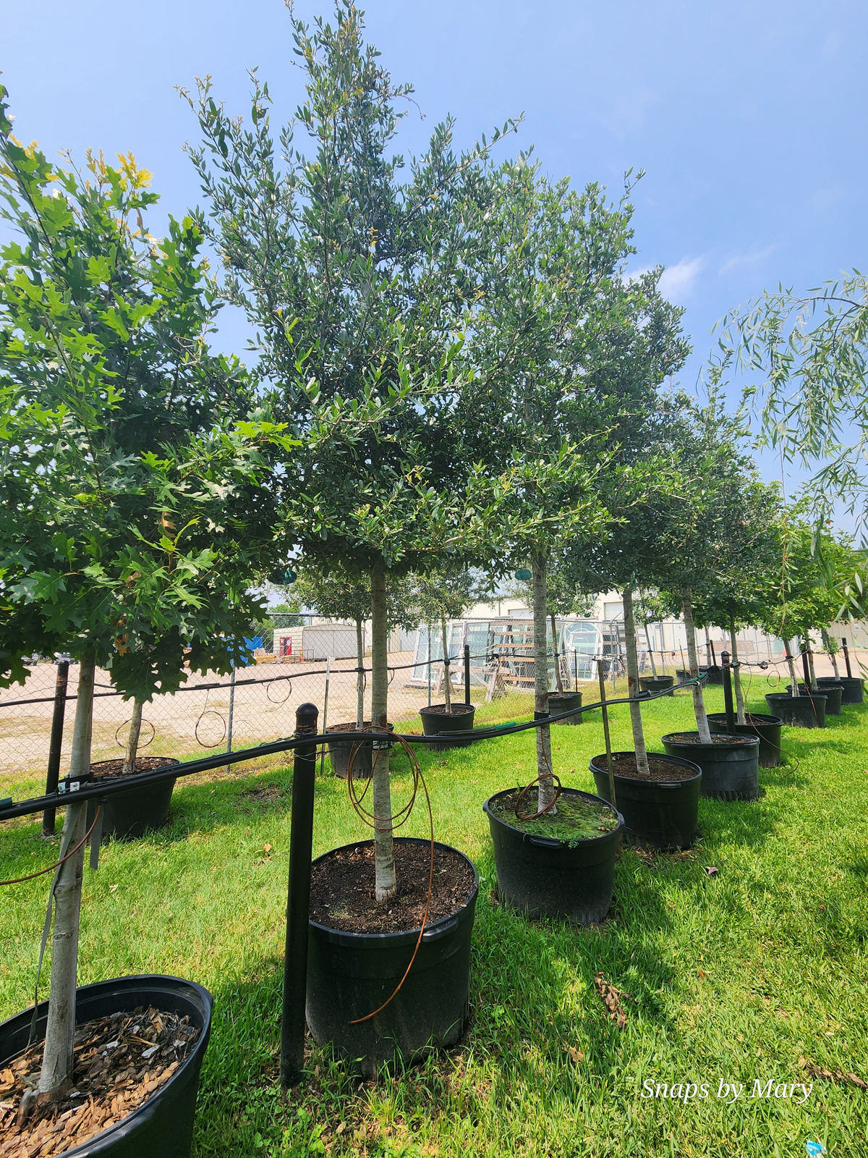
Veterans Park

Slide 8
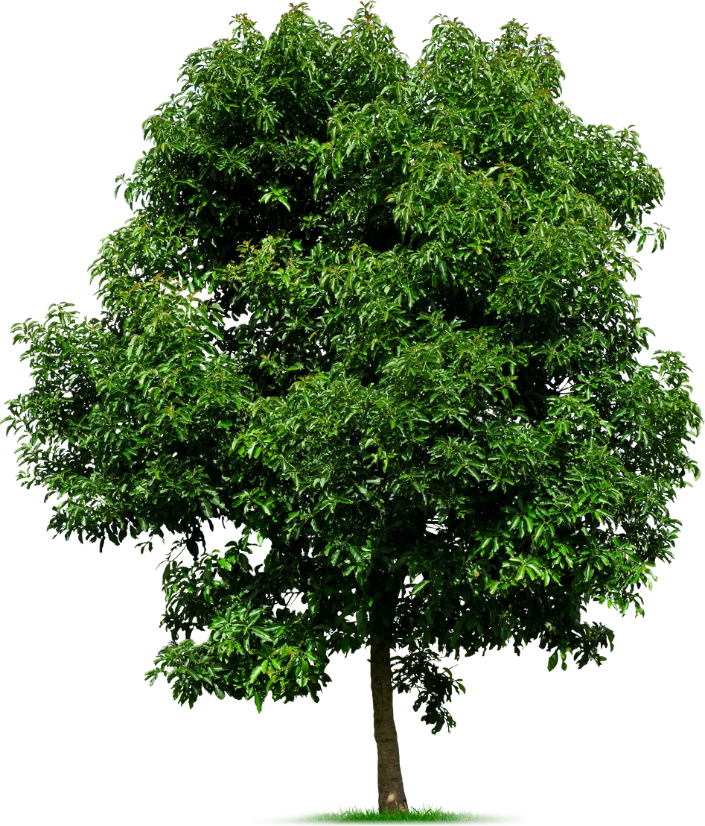
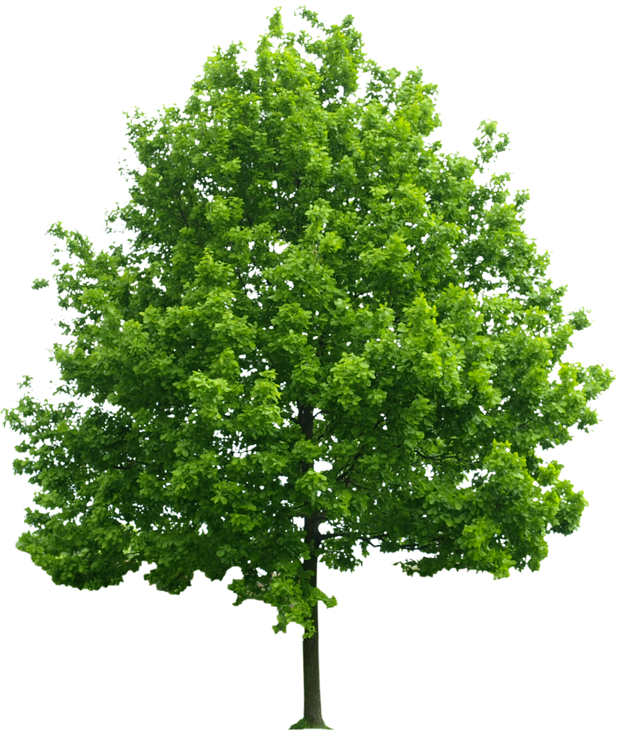
Trees best suited for Shade Ennis Tree planting campaign
Shumard Oak
Live Oak
Bald Cypress
Cedar Elm
Bur Oak
Chinkapin Oak
Pecan tree

Slide 9

Dedication plaques 11.5 x 11.5
available
An example of the stones placed at the base of each tree planted

Slide 10
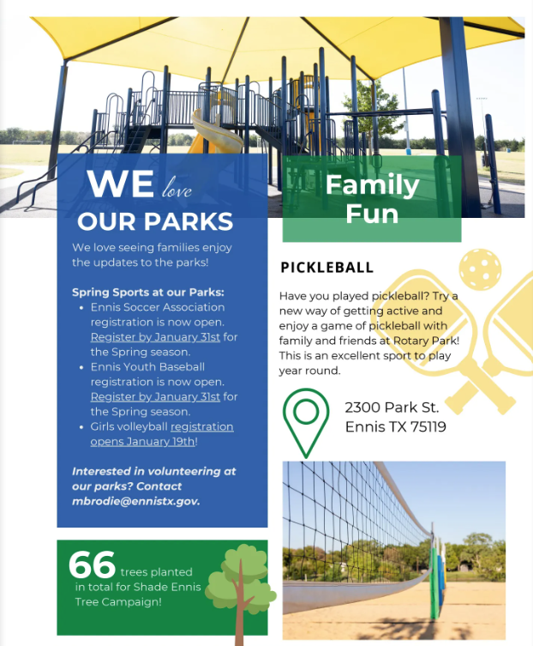
Park tree planting recap since the tree planting program launch in 2022

Slide 11
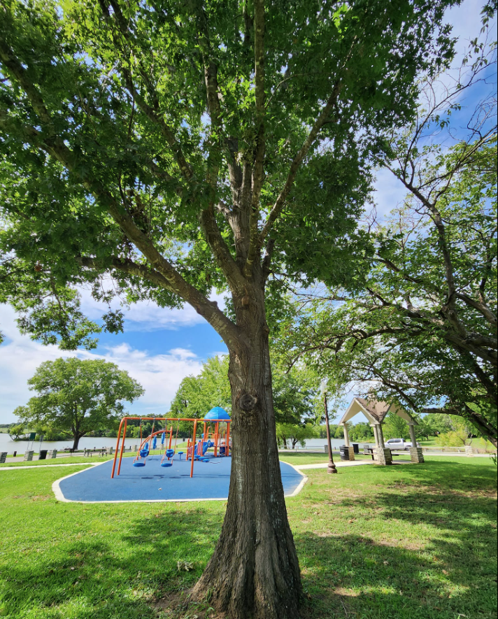
Information on Shade Ennis Project
Call Mary 972-875-1234 EXT 2419

